Slide 1
Robodog

Slide 2
Understanding Self-Awareness and the Limitations of Artificial Intelligence (AI) in the Journey to Artificial General Intelligence (AGI)

Slide 3

Machine Learning vs Artificial Intelligence (AI) vs Artificial General Intelligence (AGI)
Machine Learning (ML) is a subset of AI that focuses on a specific task. It involves training models on data and then using these models to make predictions or decisions without being explicitly programmed to perform the task.
Artificial Intelligence (AI) is a broader concept referring to machines or software that can mimic human intelligence. AI can learn from experience, adjust to new inputs, and perform tasks that usually require human intelligence.
Artificial General Intelligence (AGI) is a highly autonomous system that outperforms humans in most economically valuable work. It's about machines having the ability to understand, learn, adapt, and implement knowledge in a broad range of tasks at a level equal to or beyond human capabilities.

Slide 4
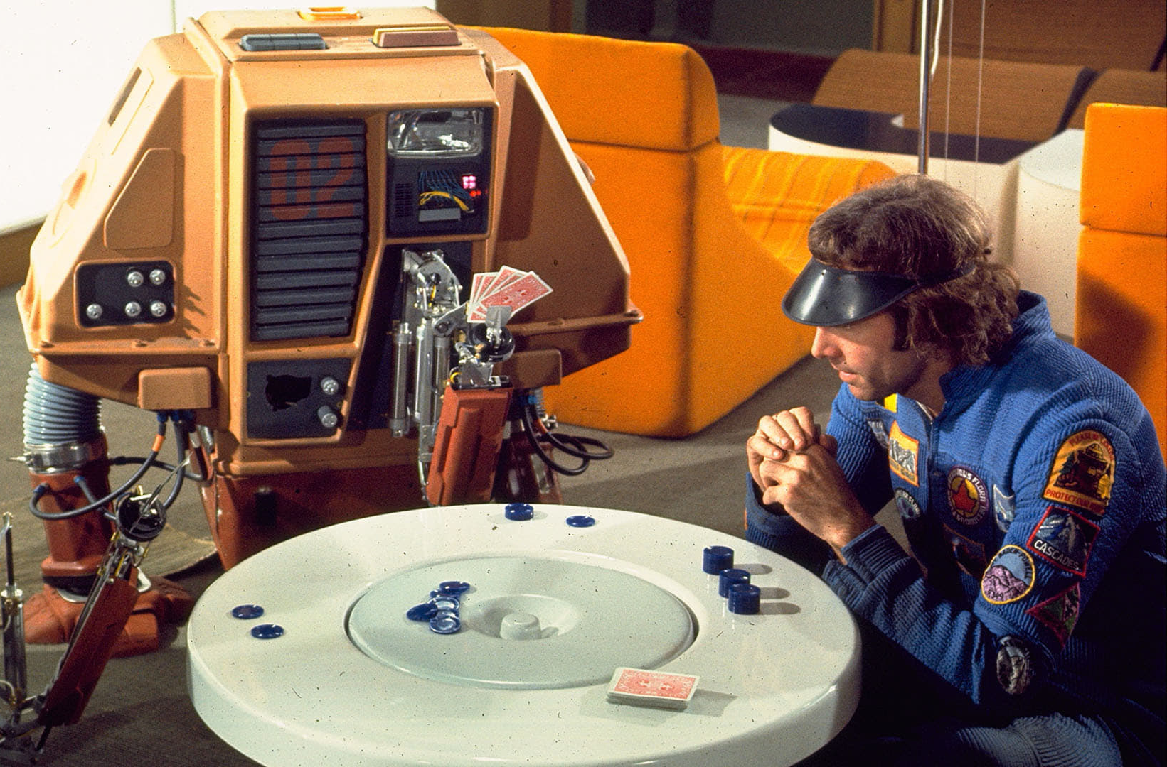
Large Language Model (LLM)
A Large Language Model (LLM) fits within the realm of Machine Learning and AI.
LLMs are trained using machine learning techniques, specifically a type called deep learning. They learn from large amounts of text data and build a statistical model that can generate human-like text.
Given that LLMs can generate responses or create content that mimics human-like text, they serve as an example of AI. They simulate a form of human intelligence, in this case, understanding and generating language.
While LLMs are impressive examples of AI, they do not fall under AGI.

Slide 5
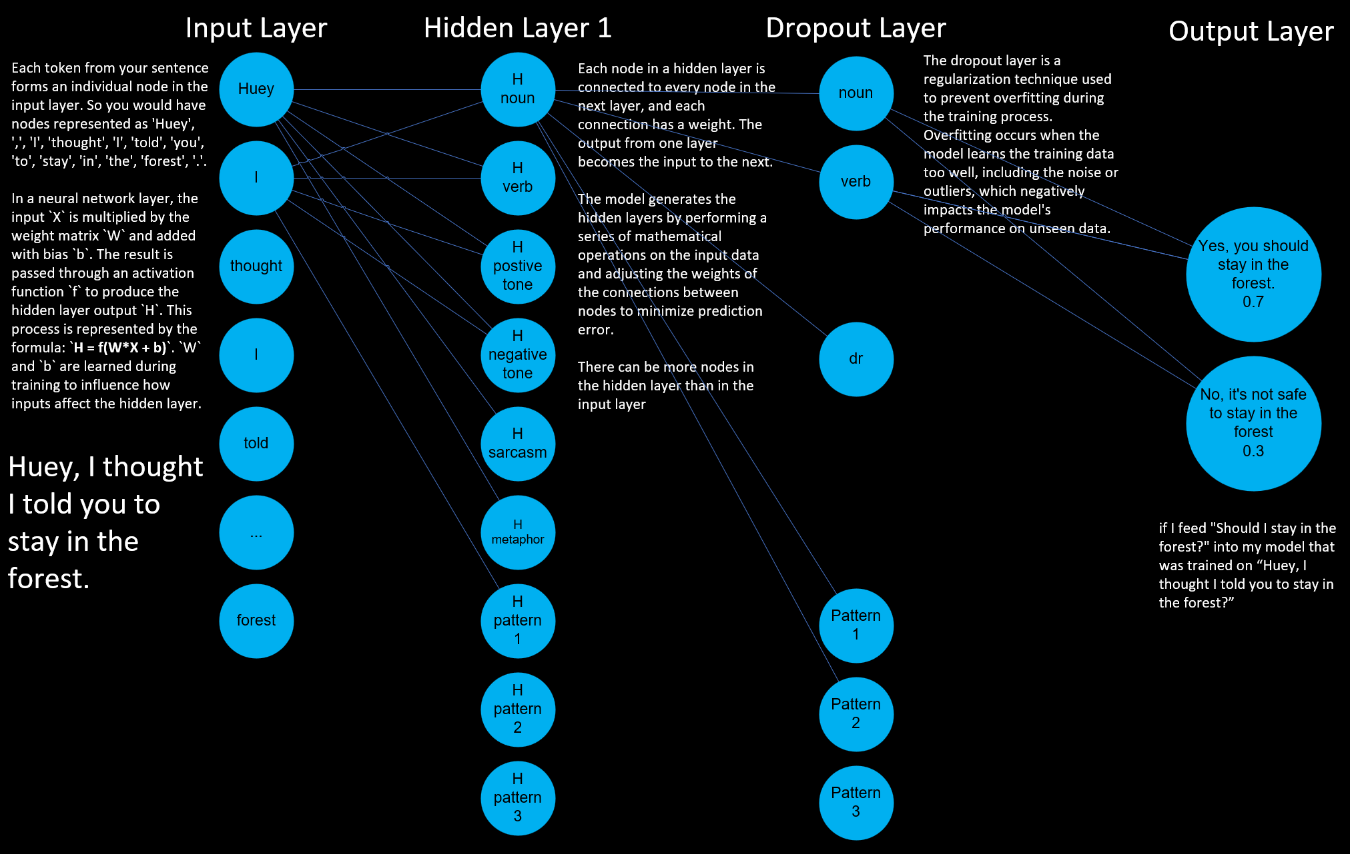
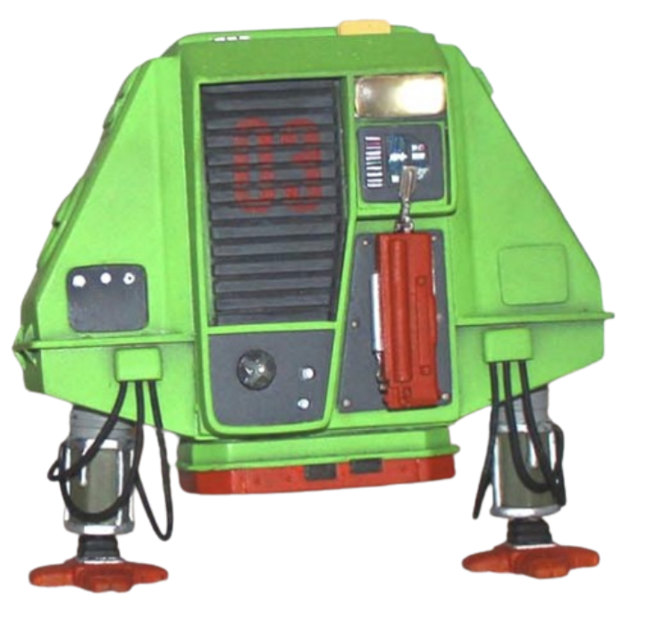

Slide 6
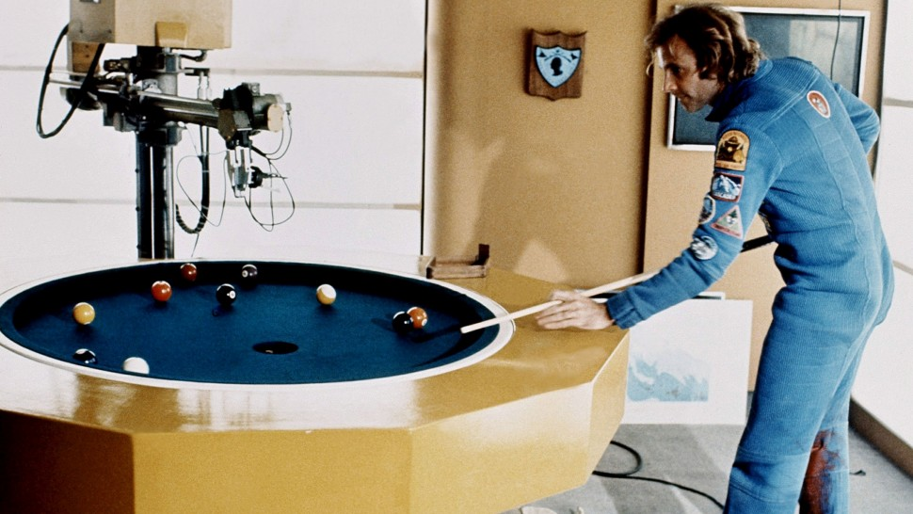
Limitations of Large Language Models
Language models like GPT can generate human-like text but don't truly understand the content.
These models are heavily dependent on the quality and nature of the input data.
Unlike humans, these models don't have self-awareness or consciousness.

Slide 7

Theories of Self-Awareness
The theory of mind suggests that self-awareness stems from our ability to comprehend that others have different experiences and thoughts. This theory could map to AGI only.
The protagonist theory proposes that we see ourselves as the central character in our life's narrative, which leads to self-awareness. This theory could map to AI and AGI.
The emergent self-theory implies that self-awareness evolves from our interactions and relationships with others. This theory could be associated with AGI.
The mirror test theory posits that self-awareness can be measured by an entity's ability to recognise itself in a mirror. This theory could fit between AI and AGI.

Slide 8
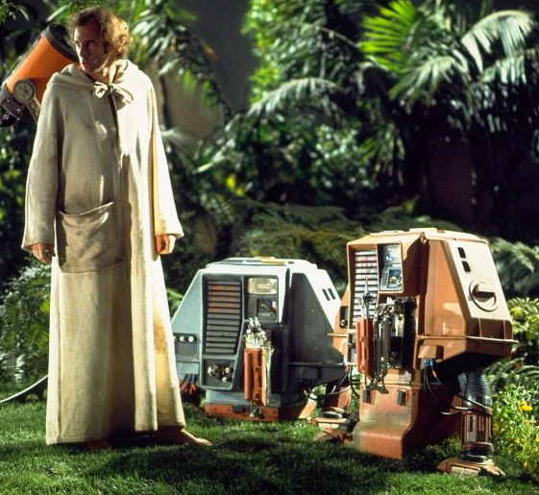
In the theory of mind, the AGI should be programmed to understand and predict the actions and thoughts of other agents (including humans and other AGI systems). In the protagonist theory, the AI or AGI needs to perceive itself as the central character in its experiences. In the emergent self-theory, the AGI might develop self-awareness through interactions and relationships with other entities. In the mirror test theory, the AGI system needs to recognize itself and distinguish its actions and state from those of others.
To make the transition from ML/AI to AGI, self-awareness is a crucial aspect.

Slide 9

Path to Artificial General Intelligence (AGI)
Incremental Improvements: Continuous enhancements in AI models and techniques.
Interdisciplinary Research: Combining insights from psychology, neuroscience, and computer science.
Ethical Guidelines: Establishing guidelines to ensure the responsible development and use of AGI.

Slide 10
Path to Artificial General Intelligence (AGI)
Level | Type | Description
1 | Chatbots | AI with natural conversation language abilities
2 | Reasoners | AIs with human-levels of problem-solving across a broad range of topics
3 | Agents | AI entities capable of autonomously making decisions and carrying out tasks either independently or based on human guidance.
4 | Innovators | AI that can aid in the invention of new ideas and contribute to human knowledge
5 | Organizations | AI that is capable of doing all of the work of an organization independently

Slide 11
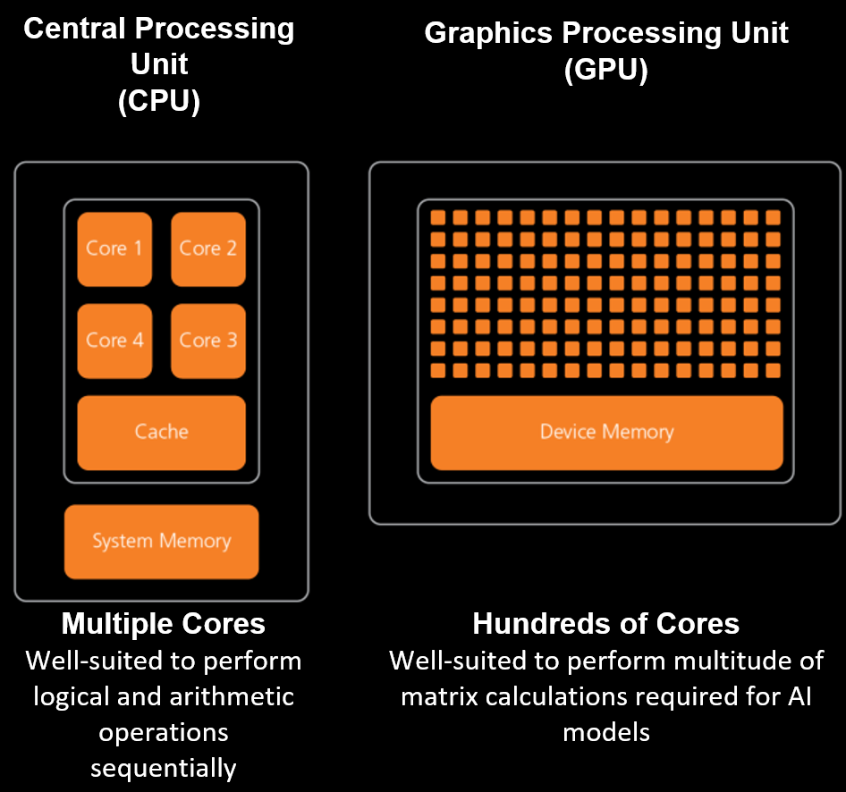
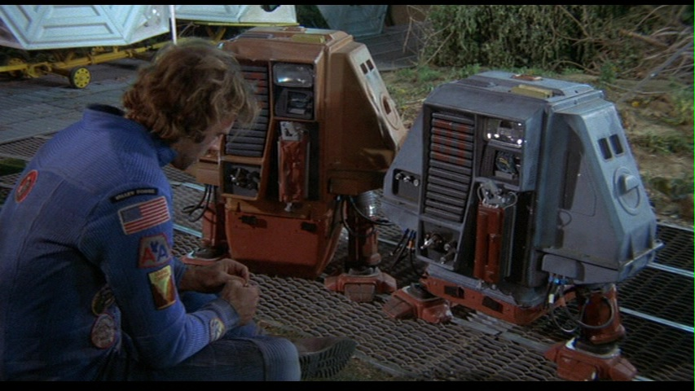
CPU vs GPU
In computer technology, traditional processors use integrated circuits made up of transistors that perform logical and arithmetic operations sequentially. These processors are typically designed to execute instructions in a linear fashion, following a predetermined set of rules. On the other hand, AI/AGI applications require more advanced and specialized chip technology to handle complex algorithms and massive amounts of data simultaneously.?

Slide 12
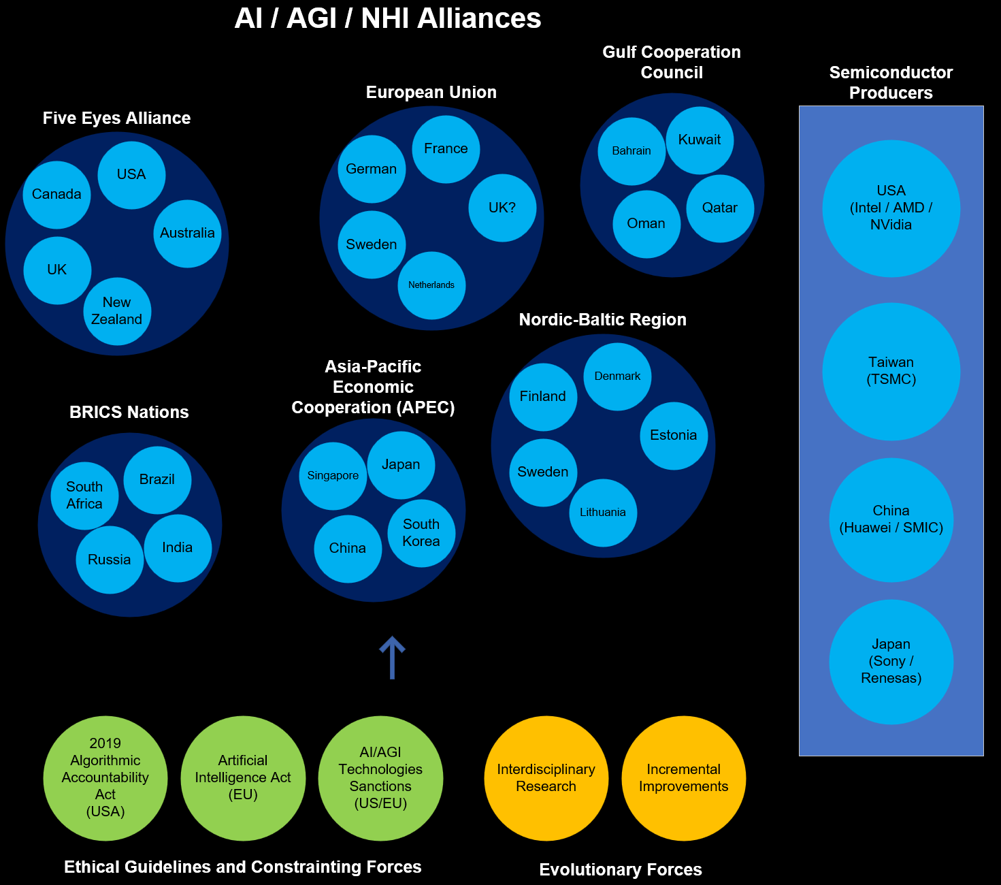

Tech Diplomacy Impact on AI / AGI NHI Progress
Tech diplomacy is a framework that recognises the growing influence of technology, particularly AI and AGI, in the global arena.
It acknowledges that tech companies, especially those pioneering in AI/AGI technologies, have become powerful entities that can impact economies, societies, and, by extension, international relations.
Notes:
1. United States: Home to leading tech companies like Intel, Nvidia, and AMD which are at the forefront of AI chip production.
2. Taiwan: Taiwan Semiconductor Manufacturing Company (TSMC) is one of the world's leading semiconductor companies.
3. South Korea: Companies like Samsung are key players in the semiconductor industry.
4. China: Despite certain restrictions, China is making strides in semiconductor production with companies like Huawei and SMIC.
5. Japan: Companies like Sony and Renesas are also involved in chip production.
1. **European Union** - EU countries are working together on AI through the European Commission's Coordinated Plan on AI.
2. **Nordic-Baltic region** - The Nordic-Baltic region has a common vision for the future of AI.
3. **Five Eyes alliance** - This intelligence alliance between the U.S., Canada, UK, Australia, and New Zealand may also collaborate on AI and AGI.
4. **Asia-Pacific Economic Cooperation (APEC)** - Some APEC countries like Japan, South Korea, Singapore, and China are leading in AI technology.
5. **BRICS nations** - Brazil, Russia, India, China, and South Africa share knowledge and technology, potentially including AI and AGI.
6. **Gulf Cooperation Council** - Middle Eastern countries like Saudi Arabia and the UAE are investing heavily in AI.
In the United States, there is the Algorithmic Accountability Act, proposed in 2019, which aims to hold businesses accountable for their use of automated decision systems, including machine learning, that result in discriminatory practices or other harms.
In Europe, the European Commission has proposed the first-ever legal framework on AI, known as the Artificial Intelligence Act, which focuses on the transparency, predictability, and accountability of AI systems. It also includes provisions for fines for non-compliance.
In the UK, there isn't specific legislation for AI ethics yet, but the House of Lords has published a report "AI in the UK: ready, willing and able?" which calls for an AI Code based on principles of understanding, fairness, transparency, and accountability. The UK government also established the Centre for Data Ethics and Innovation (CDEI) to advise on the governance of AI and other data-driven technologies.

Slide 13
Robodog
A comprehensive and portable tool designed to tokenize knowledge artefacts and interact with large language models (LLMs)

Slide 14
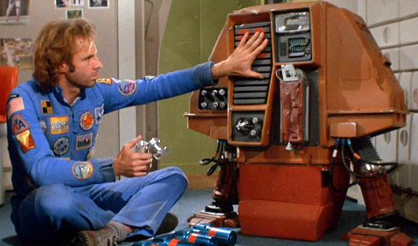
Why Create Robodog
A pre-trained transformer-based model is trained on the Internet and third-party providers license data.
These models are useful curiosities. They are not perfect, but they can help us.
Given that AGI seems far away, we must make the most of what we have now.
To do this, we must get out own knowledge into the models.
There are limitations and we must be careful.

Slide 15
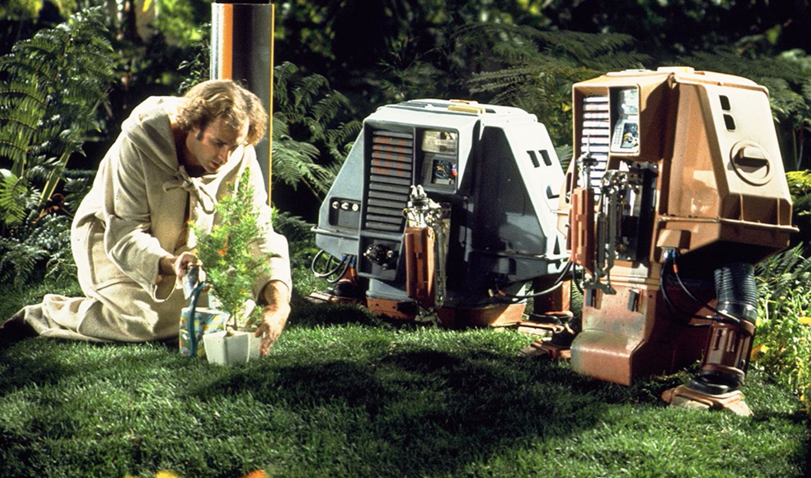
Knowledge Artifacts
Our personal knowledge artefacts are fragmented into many formats.
They are embedded into many providers: Google, Microsoft, Dropbox, Adobe, Apple
They exist in a myriad of formats, from images and PDFs to text, email, tasks, digital devices, and notes.
With Robodog, we can traverse our artefacts and convert them into a format in which a model can interact with the transformer model.

Slide 16
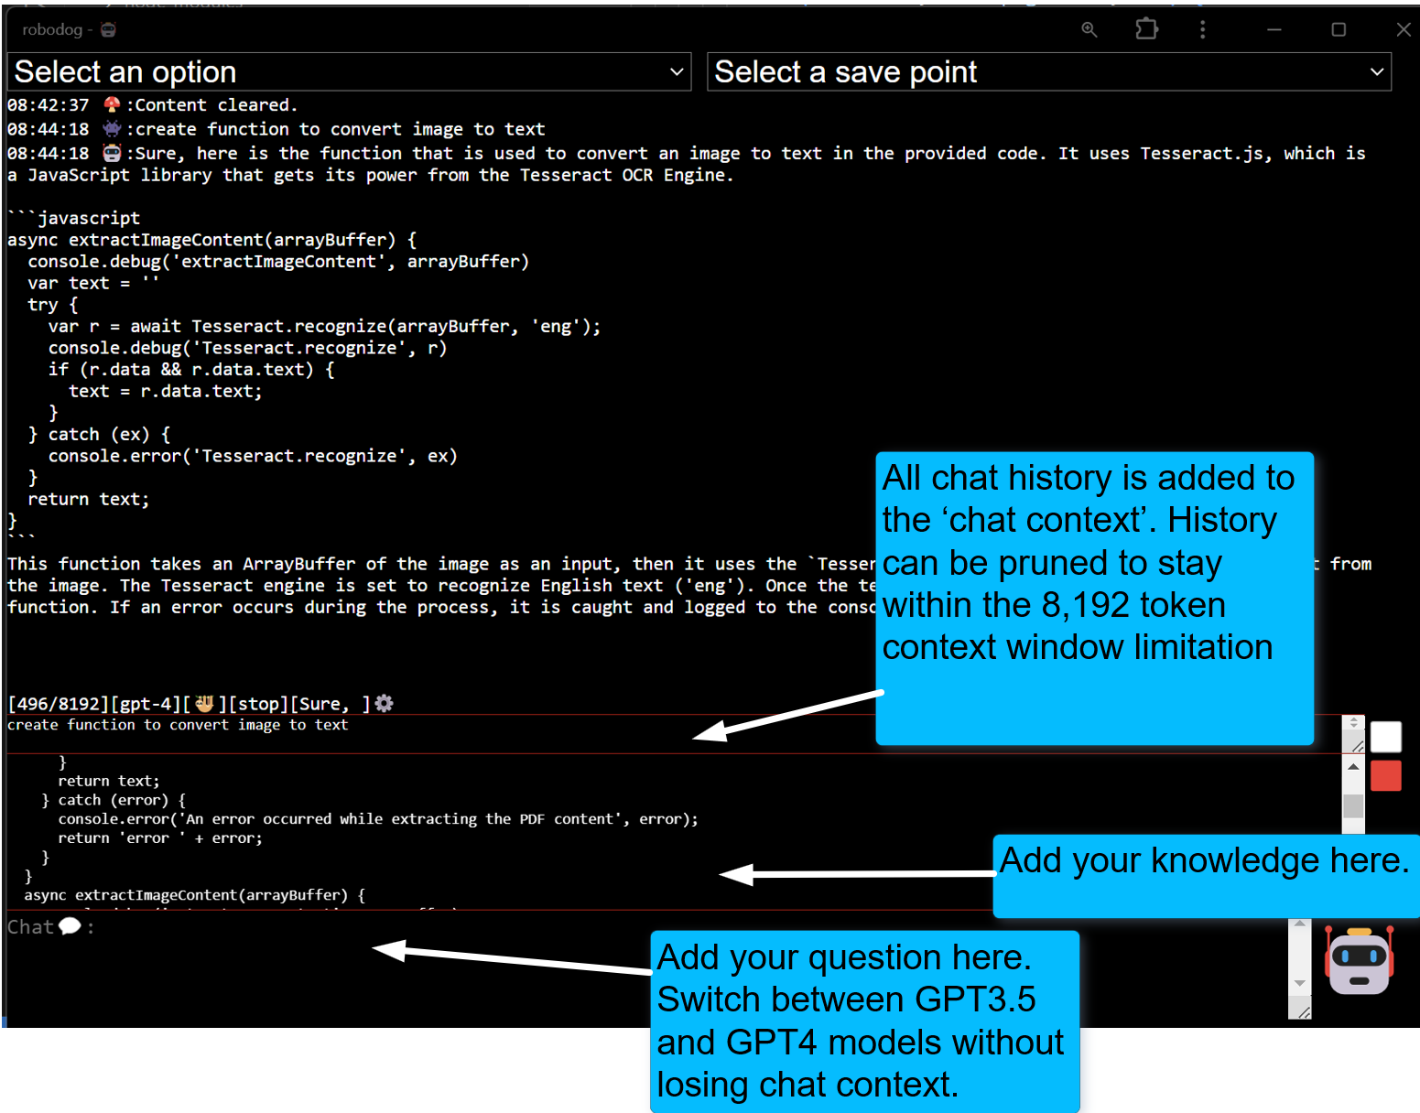
How Robodog Works

Slide 17
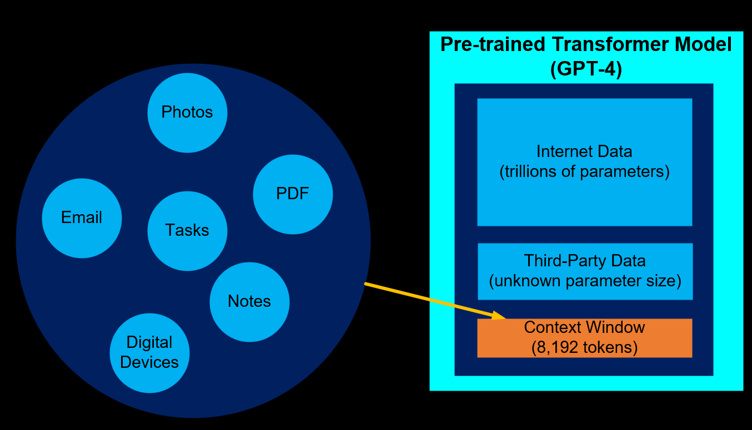
Knowledge Artifacts vs Context Window
There is no way around the limitations of the context window size.
Less expensive models are 4,000 tokens and more expensive models are 128,000 tokens
There is a need to prune the context window
The open ai custom GPT product attempts to automate pruning process using an elastic search. From experience, this does not work very well in practice

Slide 18
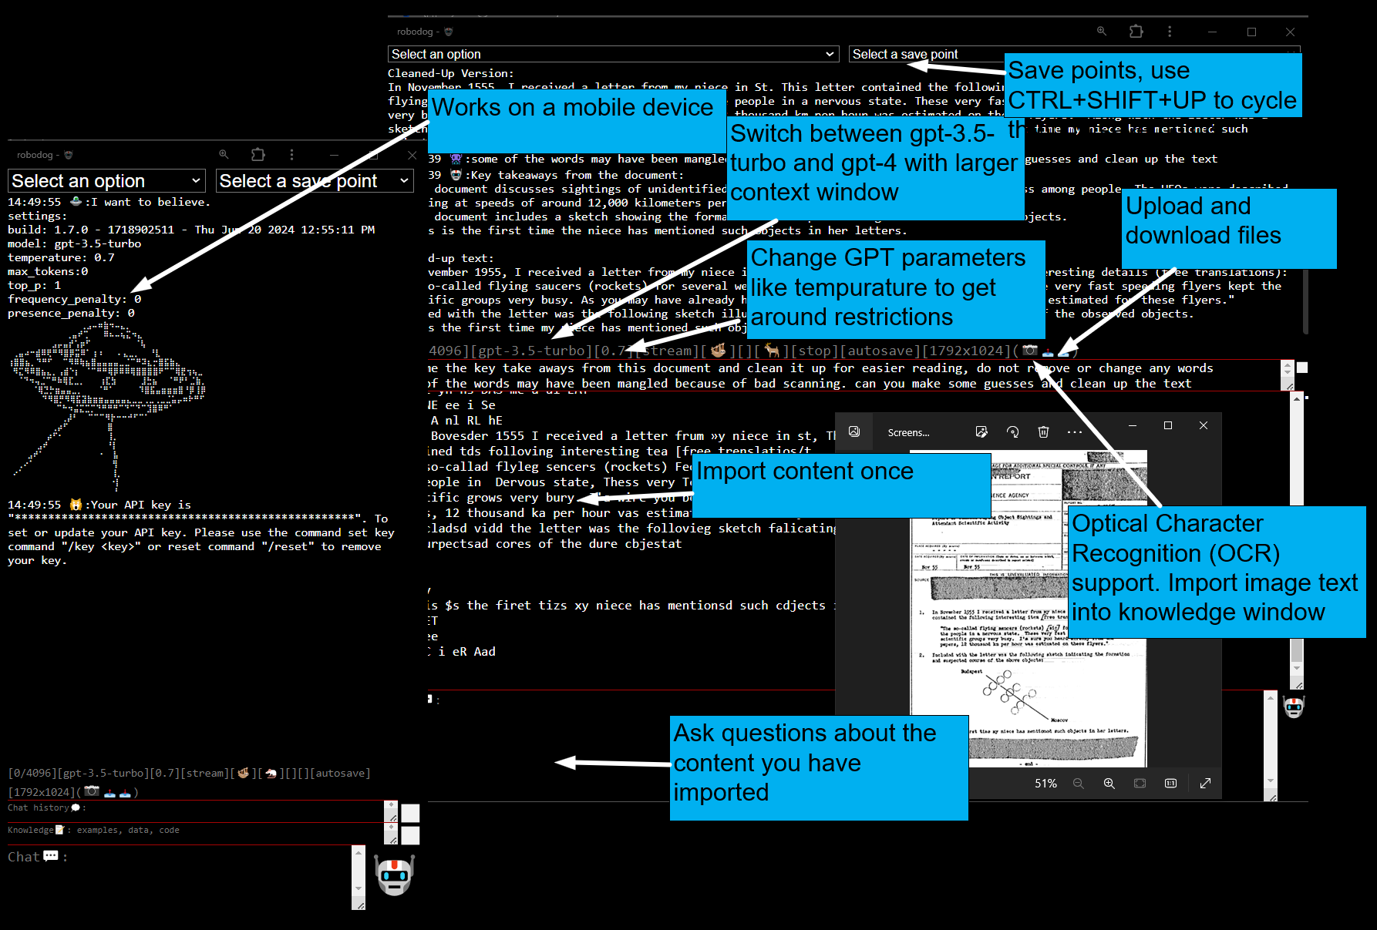
Robodog Features

Slide 19
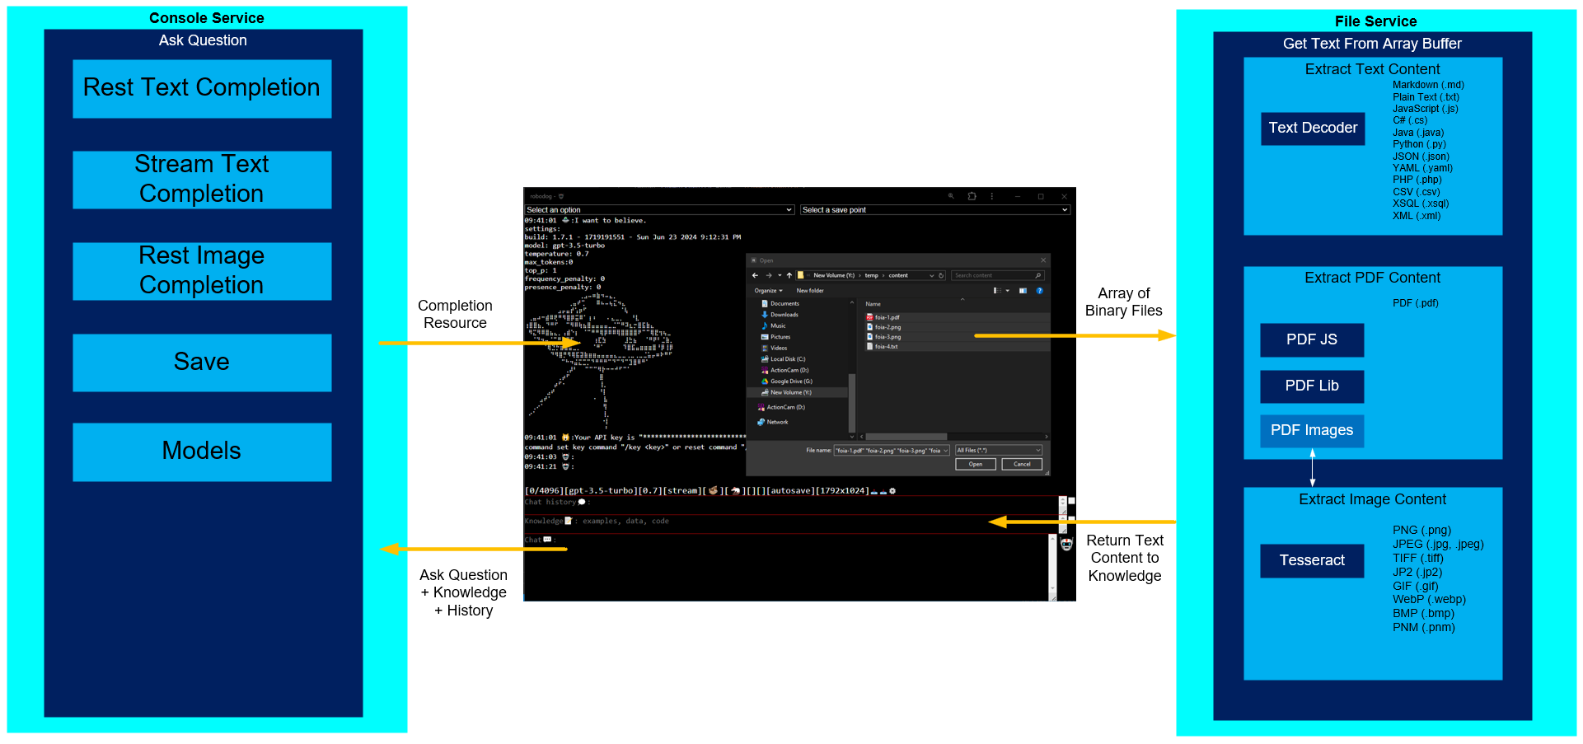
Separation of Concerns

Slide 20
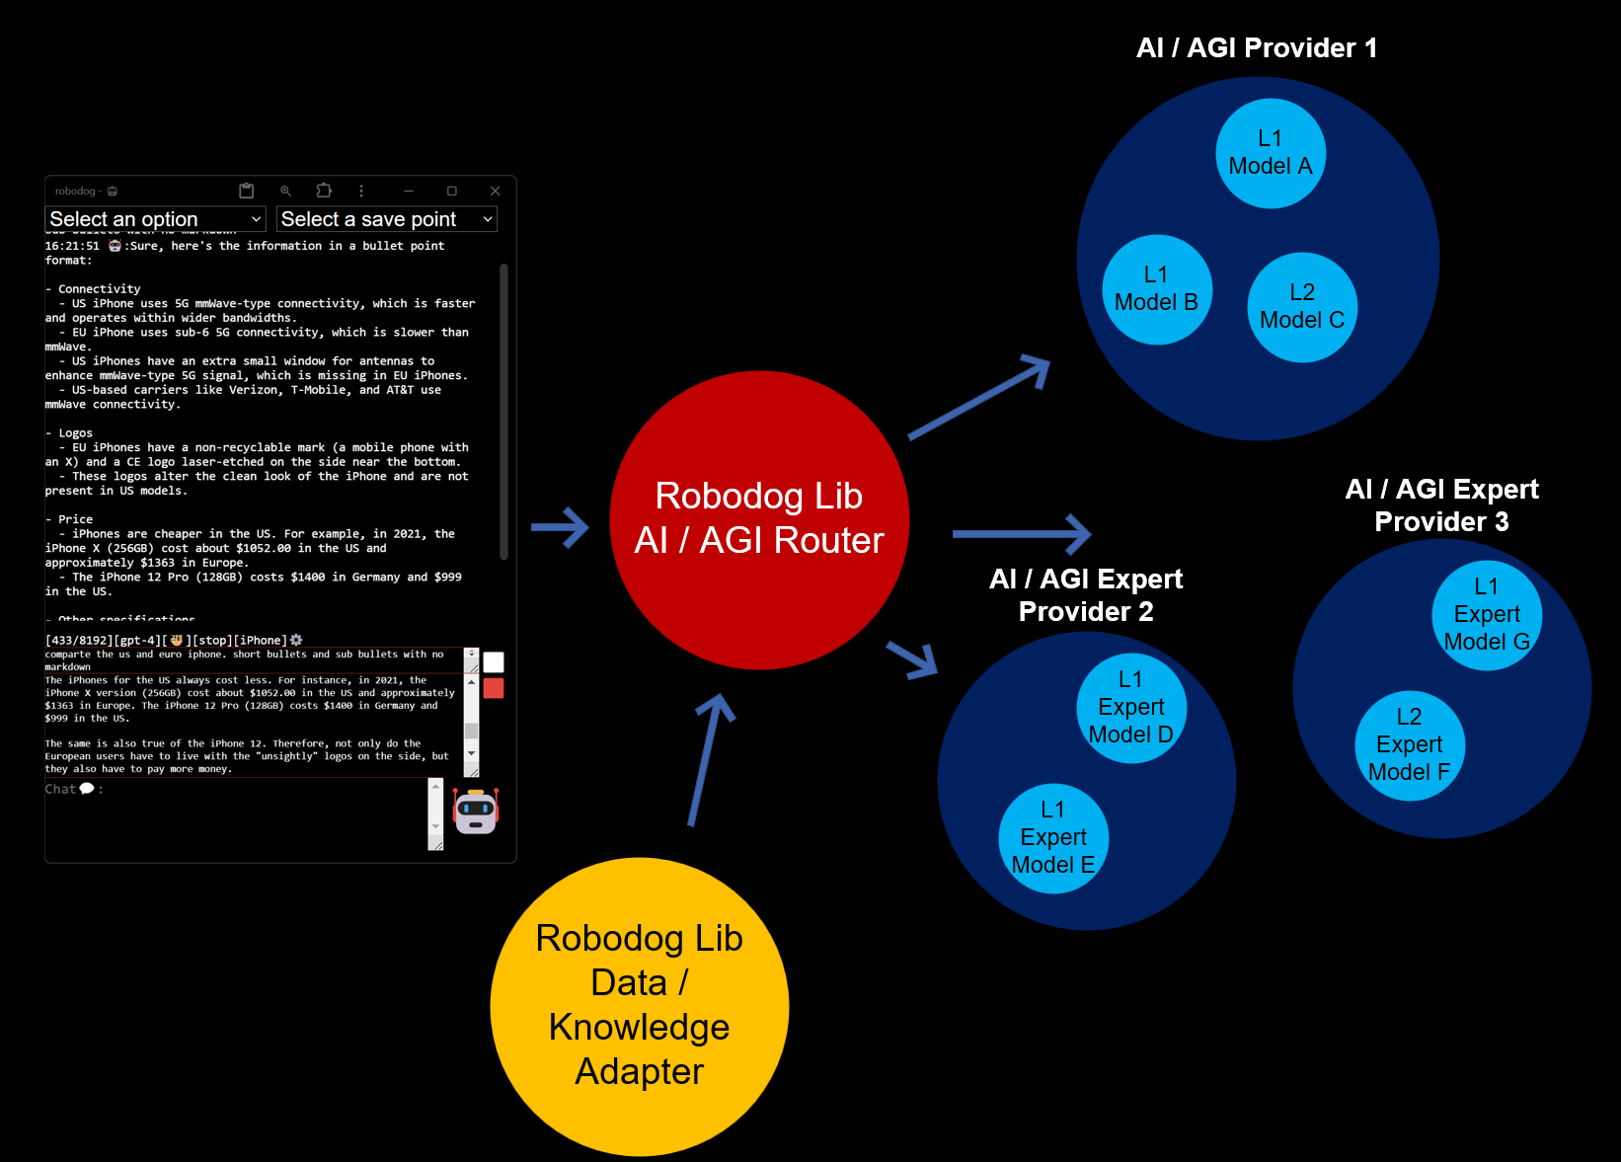

Robodog Roadmap

Slide 21
Conclusion

